Slide 1
Discussion 5 - Trees & Growth
Chris Allsman

Slide 2
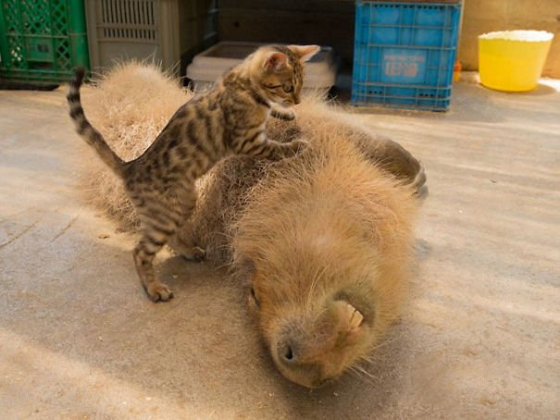
Attendance

Slide 3
tree_max
if is_leaf(t):
return label(t)
largest = []
for b in branches(t):
largest += [tree_max(b)]
return max(largest + [label(t)])

Slide 4
Simplifying tree_max
if is_leaf(t):
return label(t)
largest = []
for b in branches(t):
largest += [tree_max(b)]
return max(largest + [label(t)])
Recall this does exactly what a list comprehension does (review the relevant discussion/lab/lecture)

Slide 5
Simplifying tree_max
if is_leaf(t):
return label(t)
largest = [tree_max(b) for b in branches(t)]
return max(largest + [label(t)])

Slide 6
Simplifying tree_max
if is_leaf(t):
return label(t)
largest = [tree_max(b) for b in branches(t)]
return max(largest + [label(t)])
Let’s combine these two lines

Slide 7
Simplifying tree_max
if is_leaf(t):
return label(t)
return max([tree_max(b) for b in branches(t)] + [label(t)])

Slide 8
Simplifying tree_max
if is_leaf(t):
return label(t)
return max([tree_max(b) for b in branches(t)] + [label(t)])
Because branches(t) is an empty list when t is a leaf, the base case is redundant!

Slide 9
Simplifying tree_max
return max([tree_max(b) for b in branches(t)] + [label(t)])

Slide 10
Why don’t we check if it’s a leaf?
[f(x) for x in [ ]] will always return an empty list
[ ] + lst will return a new list containing just the elements of lst
So when t is a leaf, we’ll return max([label(t)]), which is just label(t)!
The base case is still there, it’s just not explicit

Slide 11
Growth

Slide 12
Growth
How does our program perform?
How can we measure this?
Time taken to complete?
Average time? Time compared to other programs?

Slide 13
Input Size | Time for f1 | Time for f2
3 | 11 ms | .8 ms
4 | 14.6 ms | 5.4 ms
5 | 18.5 ms | 74.5 ms
6 | 21.2 ms | 450 seconds
Notes:
Which one is better here? From what we can tell, f1
(In fact, f2 is based off of an actual function. With an input size of 7, the program can run overnight and still not finish!)

Slide 14
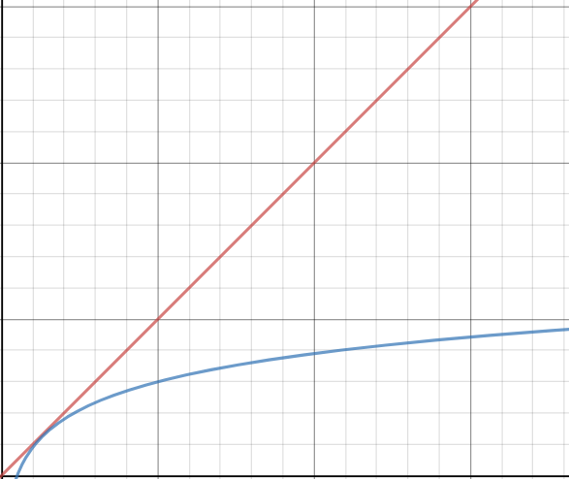
Notes:
Graph of input size vs. # of steps. The red line (linear) grows more quickly than the blue line (logarithmic)

Slide 15
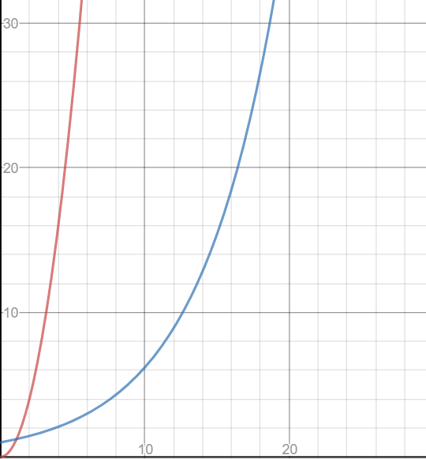
Notes:
From this information, the blue line seems to grow more slowly but...

Slide 16
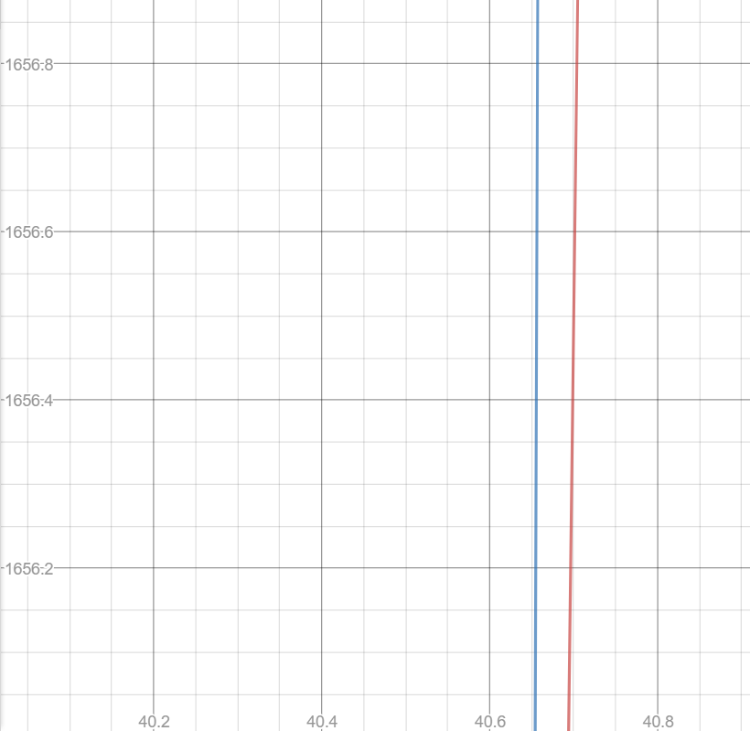
Notes:
We can see that at a larger input size, blue actually grows more quickly!

Slide 17
Theta Notation
How we describe a function’s growth
Θ(f(n)) = this function grows at rate f(n) as we increase the size of n
Can think of it as: the growth “looks like” f(n)
For those of you that like precise definitions: means that we can bound the growth of the function above and below by some multiple of f(n)
Notes:
“Looks like” as in if you plotted it, it would look like that specific function

Slide 18
Rules
Only consider behavior for very large inputs
Disregard constant factors
Only take the largest term
Θ(1) < Θ(log n) < Θ(n) < Θ(n log n) < Θ(n^{k}) < Θ(k^{n})
Notes:
Where k is some constant value

Slide 19
Tips
Know what each growth class means “intuitively”
Θ(1) = same amount of steps regardless of input size
Θ(n) = increasing input size by 1 adds some number of steps
Θ(log n) = multiplying the input size adds some number of steps
Θ(2^{n}) = increasing input size by 1 multiplies the number of steps

Slide 20
Tips
Identify the number of times we evaluate something in a loop structure and how long each evaluation takes
def fact(n):
i, total = 1, 1
while i <= n:
total = total * i
return total
Θ(1) * Ν = Θ(N)

Slide 21
Tips
Θ(1)
N
Draw out a tree for recursive calls
Θ(1)
N - 1
def fact(n):
if n <= 1:
return 1
else:
return n * fact(n-1)
Θ(1)
1

Slide 22
Disregard constant factors
Only take the largest term
Θ(1) < Θ(log n) < Θ(n) < Θ(n log n) < Θ(n^{k}) < Θ(k^{n})
Θ(1) = constant # of steps
Θ(n) = add 1 to n, add steps
Θ(log n) = multiply n, add steps
Θ(2^{n}) = add 1 to n, multiply # of steps
1 + 2 + 3 + … + n = n(n - 1) / 2
a + ar + ar² + … + ar^{n} = a(1 - r^{n})/(1 - r)

Slide 23

Midterm Tips

Slide 24
Study Strategy
Check out one potential schedule on piazza (@333)
Next few days: focus on HW, Maps.
Review discussion worksheets and lectures for topics that still don’t make sense

Slide 25
Taking Midterms
HW/Projects/Discussions are great for familiarizing you with the material
The only way to prep for the midterm is to practice midterm-level questions
That being said…
Focus on the quality of your studying, not the number of tests you take

Slide 26
How I Practice Midterms
Take your first midterm blind
Don’t worry if you’re unprepared
Don’t take it with the textbook/lecture notes open
Don’t worry if you feel like you didn’t get anything
After you’ve spent at least 10-15 min on every problem:
Debrief each question. What did you know? What didn’t you know?
Take notes on it, and take some time to go back and study those areas

Slide 27
How I Practice Midterms
For each midterm you take, also identify areas that you struggle with, but also:
Build your cheat sheet. If you make same the mistake more than once, make sure to put it on there
When you look at the solutions, take some time to debrief. How could you get to this solution in the future? What in the skeleton/doctests would help you?

Slide 28
How I Practice Midterms
Don’t worry when you struggle with a problem
The dirty TA secret: we often struggle with these problems!
The difference is we’ve built strategies for approaching them
The most important thing is recognizing patterns and developing problem solving strategies
If you follow the previous suggestions, you’ll get better at these with each question you get through!

